Slide 1
Submitted By :- INTERNAL GUIDE :-
Patel A. P. Prof. M.D.Patel
Patel B. M.

Slide 2



Slide 3


Title of Project : CAMPUS SELECTION SYSTEM
Aim Of Project : It is developed for online Campus Selection System for Students.
Developed By : Patel A. P.
Patel B. M.
Front-End : ASP.NET 3.5 with C#
Back-End : Sql Server 2008
Operating System : Microsoft Windows 7
Project Guide : Mr. M. D. Patel

Slide 4
Front End Tools :-
- ASP.NET 3.5. With code behind C#
Back End Tools :-
-SQL server 2008
Documentation Tools :- - MS Visio 2003 - Photoshop 7.0 - Microsoft Word

Slide 5
The project titled “Campus Selection System” aims at developing a system, which will automate the functioning of the HR Department / Admin. This project automates the selection process activities that the HR Department has to perform prior to and after the actual act of selecting the Students.
The HR Director who has all the powers and permissions is allowed to create new users. The aspect of testing and implementation are also a very important phase. The Students needed to be educated about the various facilities available and how best these can be used .A restricted system of online help has been designed to help the user while he/she uses the system.

Slide 6


Slide 7
Allow online requests and support for the
examination.
Providing proper Technical Assistance to
the User.
Providing On-Line Help

Slide 8
Admin Module :
Here Admin should manage user's and employee’s account in various way if any of user or employee found that abuse of site than admin can ban him. Admin also can maintain master level database details and can fill entry in the various master table fields like city, state, country, products, categories etc.
Student Module :
Student is registered by the this site. A student can apply job for company and eligible students give a online Exam which is held by company.

Slide 9

Company Module :
Here Company is a person with a given or not given appropriate authentication and privileges. Company can perform all level tasks such as post a job and take a on-line exam as well as their manage our status through the site.

Slide 10

Registration :
Student can register his details and upload his resume. Similarly company can register for Required skilled student for specific job.
Apply for Job :
After login in system, student apply for job according to his/her skill and result of exam.
Post Job Module :
In this module company can post for a job and send a mail to admin for required vacancy of employee.

Slide 11
On-Line Exam Module :
In this module company take a various types of exam to select a eligible students. There are various types of test available such as aptitude test, technical test, general test, English test.

Slide 12
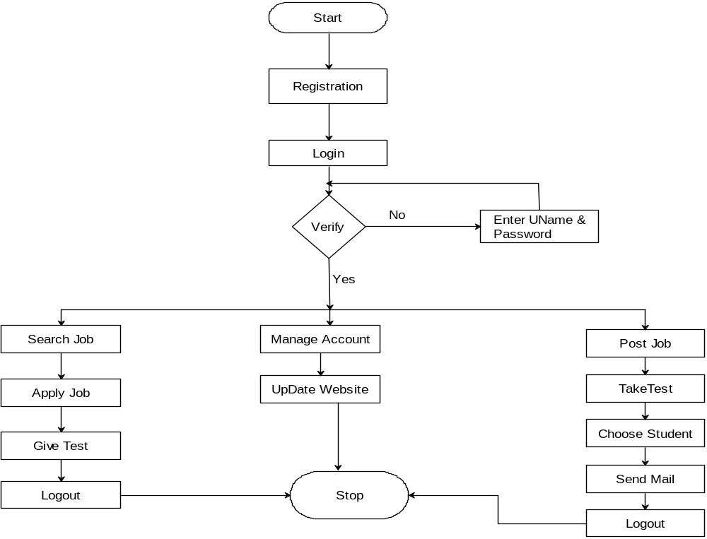
Student
Admin
Company

Slide 13
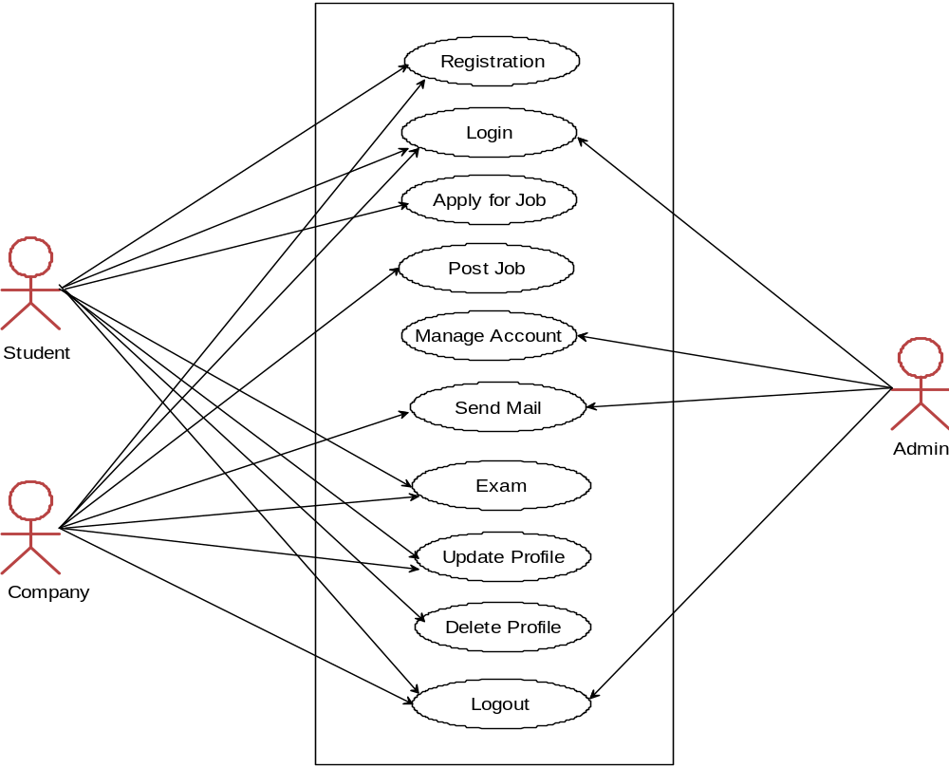

Slide 14
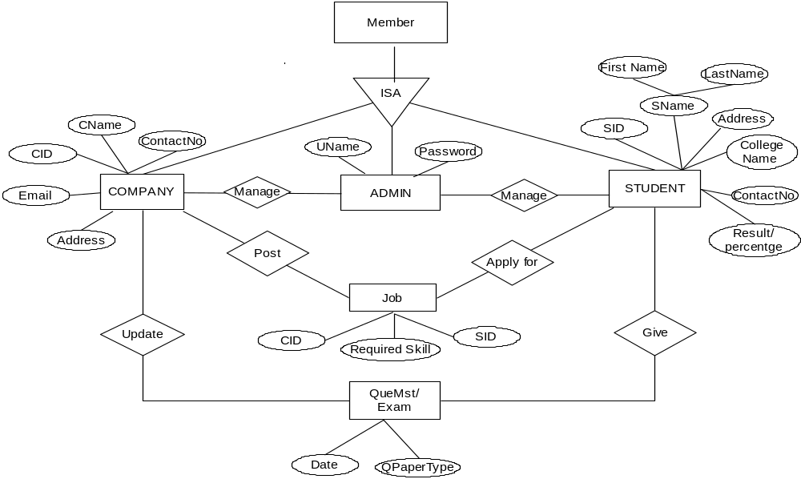

Slide 15

In general, processes of Campus selection: The Eligible Students or users can get interested job in desired company. That set of concepts is used to build a system for easily communication between students and company and company can get required eligible employees.

Slide 16


